Slide 1
Lecture 16: MRI Signal and Image Formation
Dr. Guohua Cao （曹国华） caogh@shanghaitech.edu.cn
School of Biomedical Engineering
ShanghaiTech University
5/22/2024

Slide 2
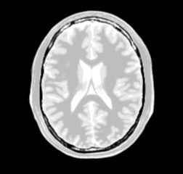
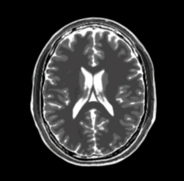
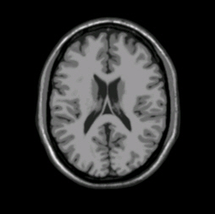
Two fundamental questions about MRI.
1) What determines the contrast in an MRI image. In other words, how does the pulse sequence change the signal intensity of an individual pixel?
2) How is the signal intensity of a single pixel assigned to a particular pixel location (i.e. spatial resolution) in an MRI image?
Notes:
Changes in the amplitude (contrast) of the MRI signal are independent of changes in the phase and frequency of the MRI signal ( spatial encoding).

Slide 3
Three Types of MR Signals
Type of Signal | Method of Formation
Free Induction Decay (FID) | 1 RF pulse
Spin Echo (SE) / Hahn Echo | 2 RF pulses
Stimulated Echo (STE) | 3 or more RF pulses

Slide 4

FID for 90° RF pulse. Note there is no magnetic gradient.
Notes:
Coils can receive the signal in the transverse plane due to variations of transverse magnetization vector.
This signal is oscillating at resonance frequency and signal enveloppe is a decay curve described as an exponential curve.
After a 90° RF pulse, net magnetization tips down so that longitudinal magnetization has disappeared and transverse magnetization has appeared.

Slide 5
What is a FID?
The simplest form of MR signal
Created by a single RF-pulse that tips magnetization into the transverse plane
FIDs were the first MR signals independently observed by Bloch and Purcell

Slide 6
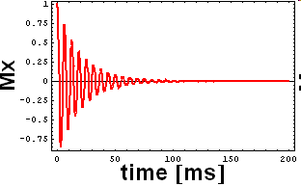
Single RF Pulse Tips Magnetization into Transverse Plane, Creating an FID
Mz
1
z
0.8
My
M
0.6
0.4
0.2
Mx
0
0
50
100
150
200
time
[ms]
Notes:
What is the direction of the original RF pulse?
What would the curves look like if T1=infinity?
What would the curves look like if T2=infinity?
Why is T2 always less than T1?

Slide 7
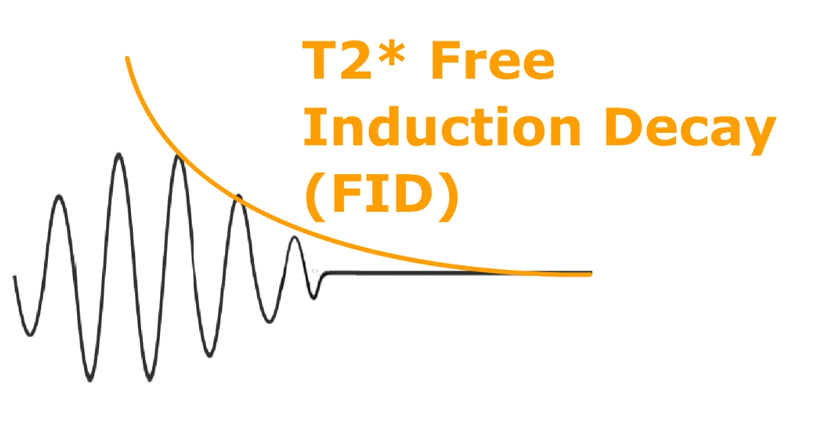
T2* rather T2
T2’ is the relaxation constant due to magnetic field inhomogeneity alone
Notes:
sue specific spin-spin relaxation (random interactions between spins) responsible for pure T2 decay
static inhomogeneities in magnetic fields which accelerate spins dephasing.
T2* is always shorter than T2. T2* signal decay is lower than pure T2 signal decay.

Slide 8
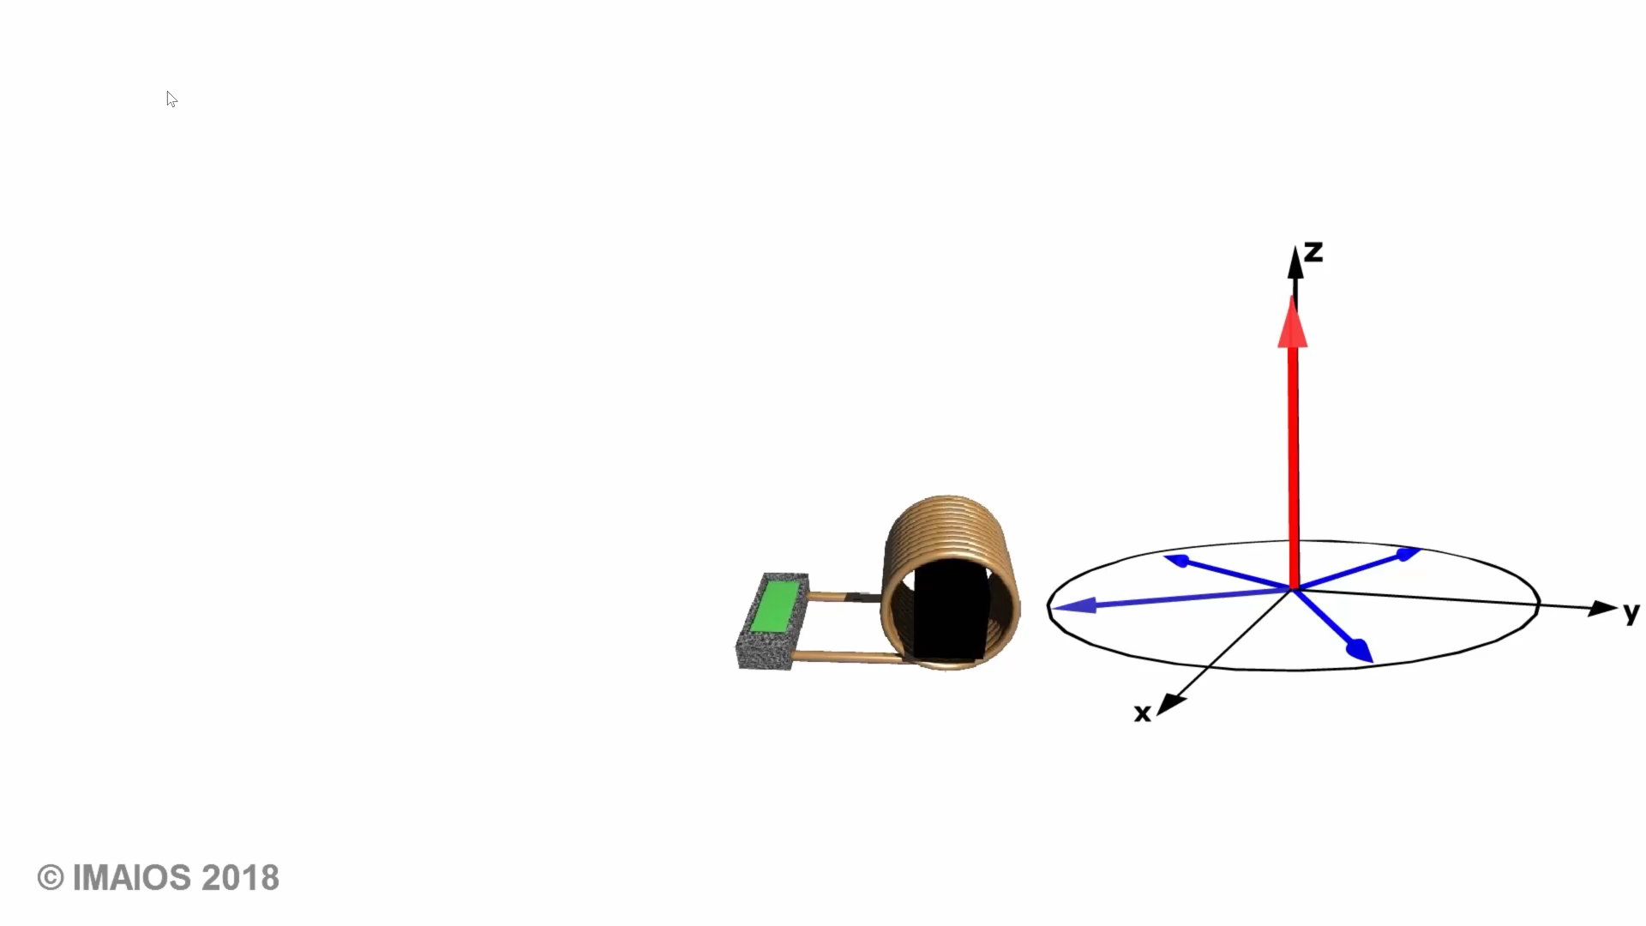
180° RF pulse
Notes:
A 180° RF pulse can rephase spins and reverse static field inhomogeneities. After a 90° RF pulse, spins dephase and transverse magnetization decreases. If we apply a 180° RF pulse, spins rephase and transverse magnetization reappears.
The 180° RF pulse restores phase coherence:
After the 90° RF pulse spins dephase (during a time defined as TE/2)
After the 180° RF pulse, spins are back in phase at time TE after the 90° RF pulse
Then they dephase again.
At time TE (Echo Time), the signal is not as high as the initial transverse magnetization intensity. As the 180° RF pulse reverses dephasing due to static field inhomogeneities but not spin-spin relaxation, the signal loss is due to pure T2 effect.
The signal enveloppe joining maximums of echos after 180° RF pulses is corresponding to the pure T2 decay curve.
How can a 180° RF pulse rephase spins? Consider the following race:
Once the race starts (the relaxation begins), the turtle and the rabbit are at the same place (the starting line): they are in phase.
As the rabbit runs faster, there is a distance between him and the turtle: they dephase.
Then both have to turn around and go back (180° RF pulse).
Assuming they are both going at the same speed as before, they arrive at the same time at the starting (finish) line : they rephase.

Slide 9
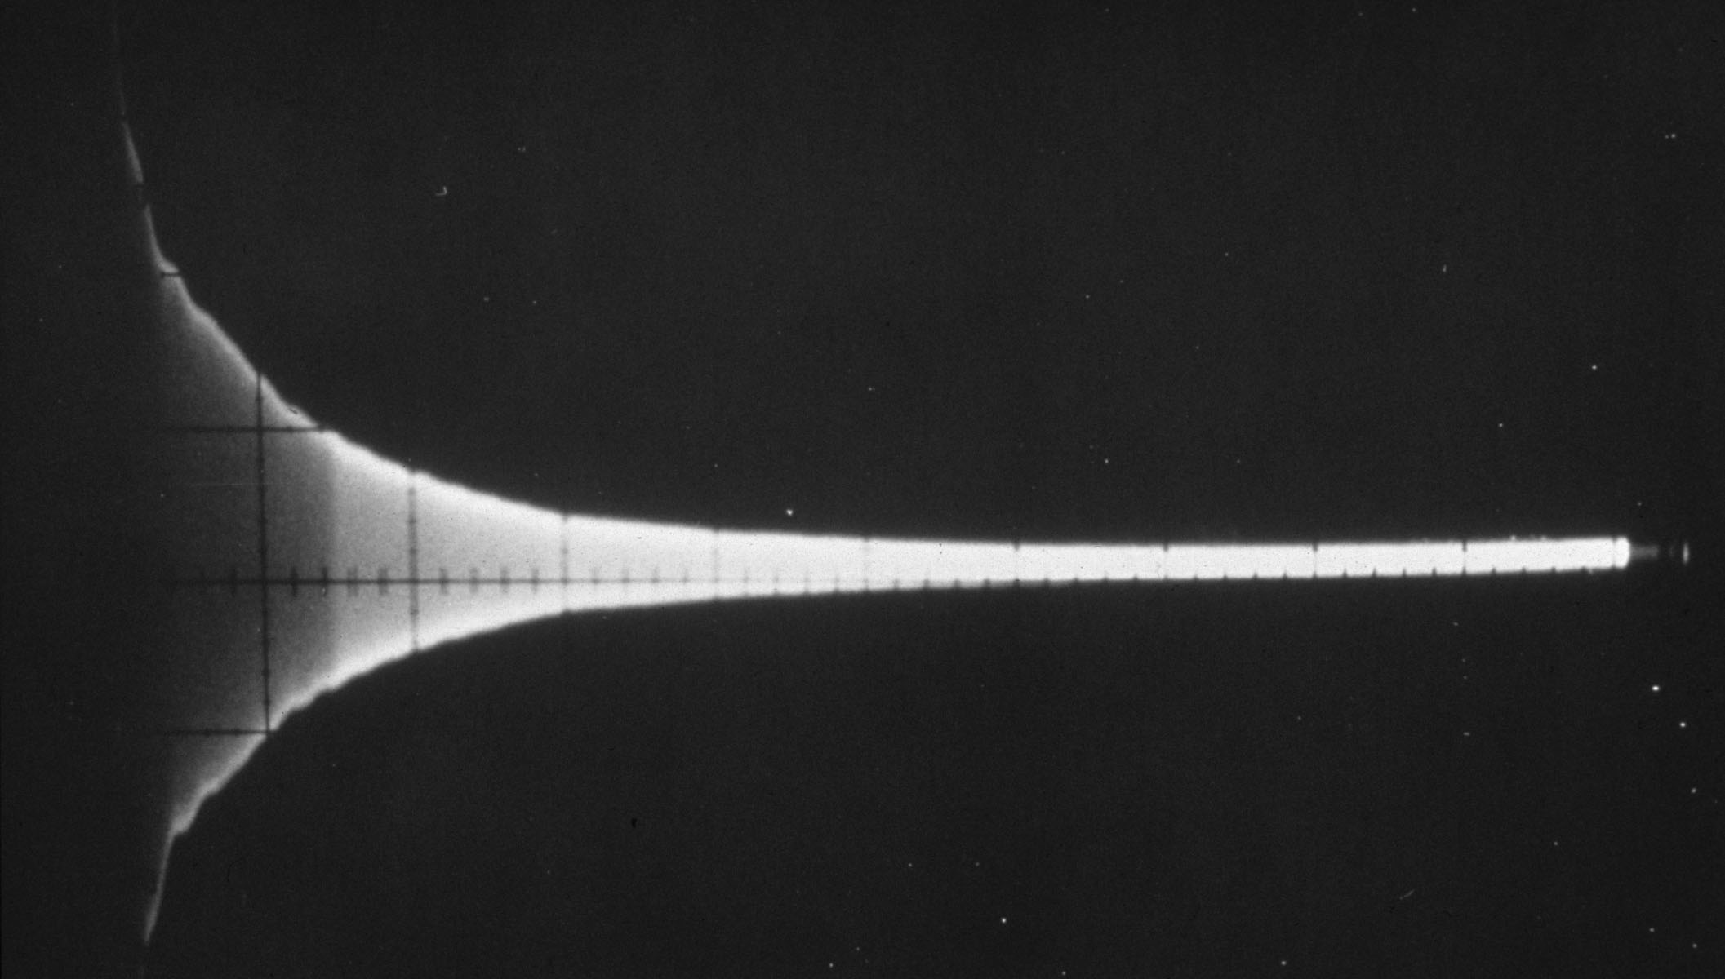
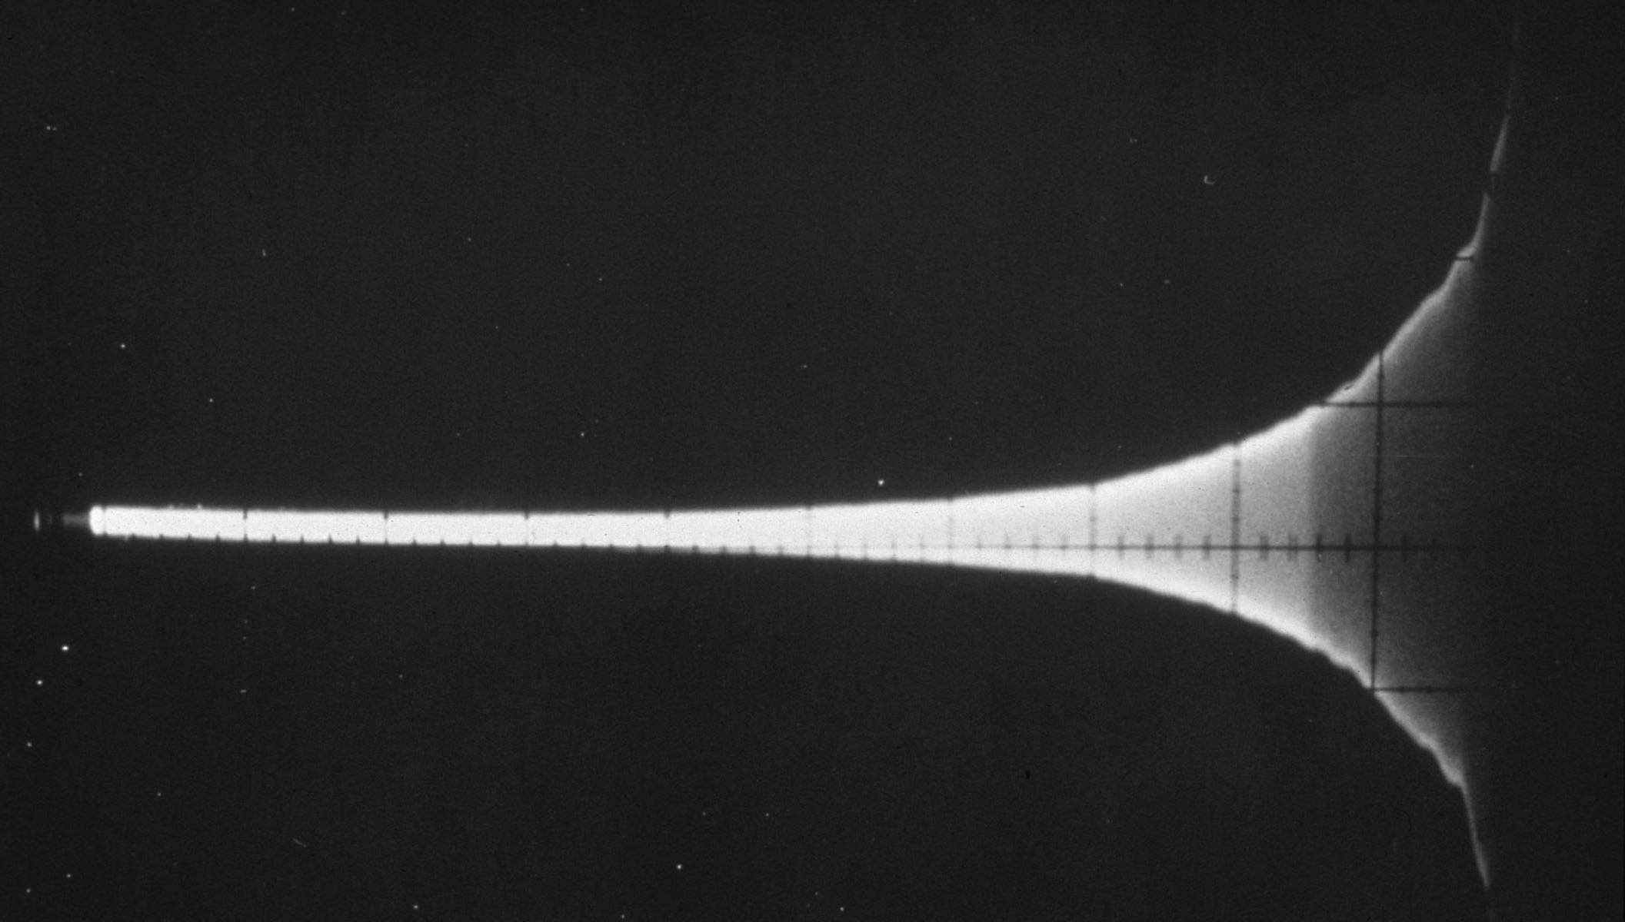
What is spin echo?
θ₁
θ₂
time
Spin echo is formed from combination of any two RF pulses.
An echo is a recovery of transverse magnetization that was lost due to magnetic field inhomogeneities (T2’) from the first FID.
The amplitude of the echo will never be larger than the amplitude of the first FID. Why?

Slide 10
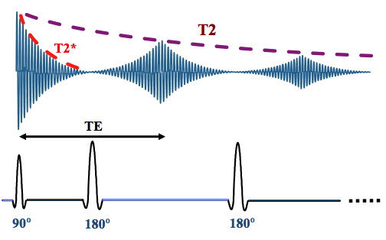
What is Spin Echo time (TE)?
Notes:
Repetition Time (TR) is the amount of time between successive pulse sequences applied to the same slice. Time to Echo (TE) is the time between the delivery of the RF pulse and the receipt of the echo signal.

Slide 11
How do you analyze a spin echo pulse sequence acquired at TE+dTE?

Slide 12
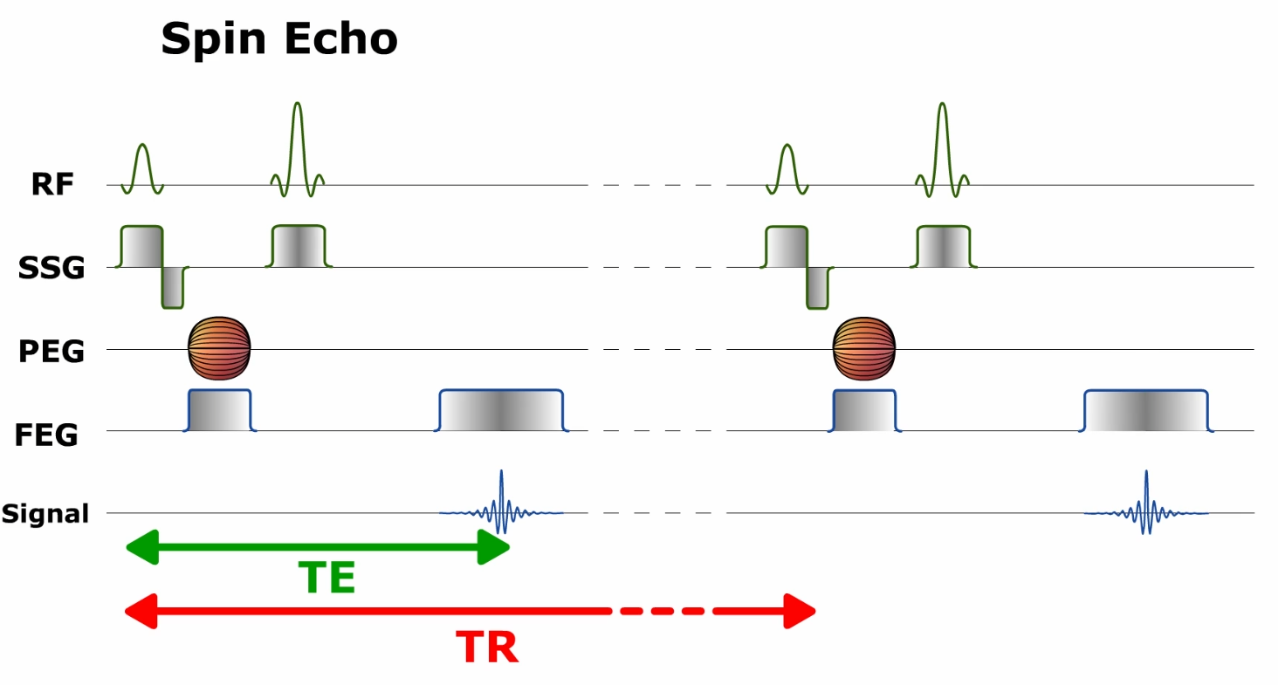
Spin echo, TR, TE
TE: time of echo, the time between the delivery of the RF pulse and the collection of the echo signal
TR: time of repetition, the time between successive radiofrequency pulses (RF)
Notes:
Echo Time (TE) is the time between the 90° RF pulse and MR signal sampling, corresponding to maximum of echo. The 180° RF pulse is applied at time TE/2.
Repetition Time (TR) is the time between 2 excitations pulses (time between two 90° RF pulses).

Slide 13
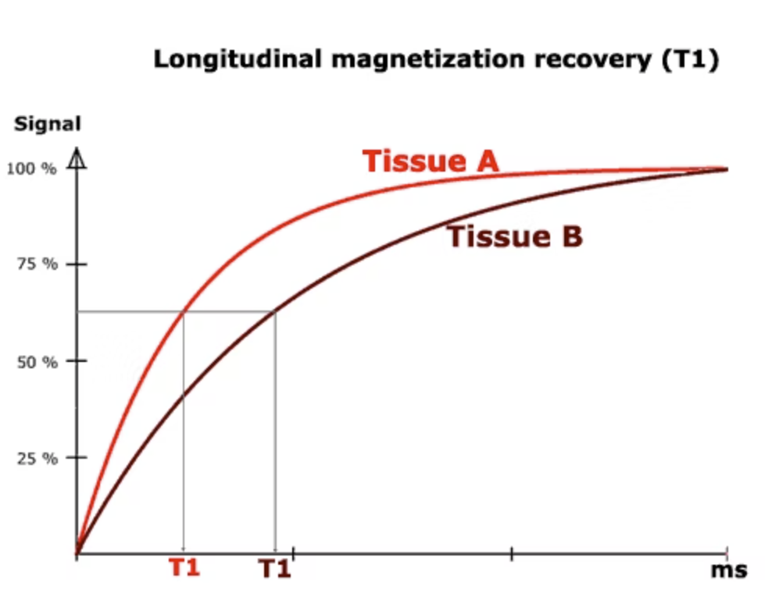
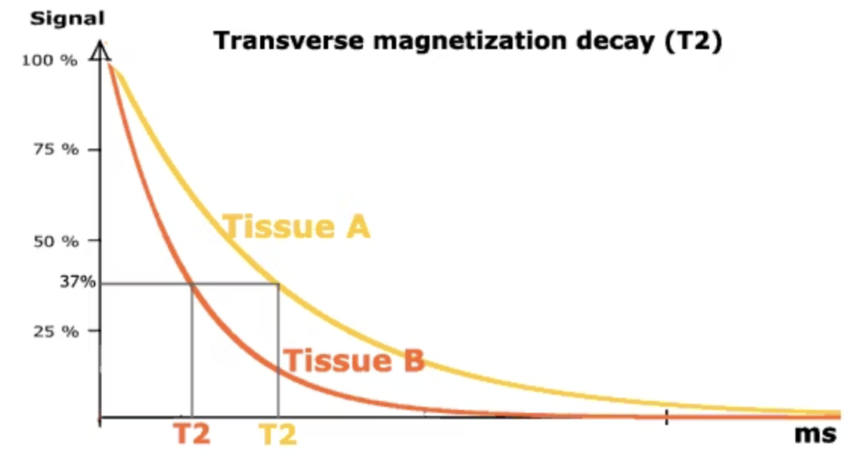
Tissue A and Tissue B have different T1 and T2.

Slide 14
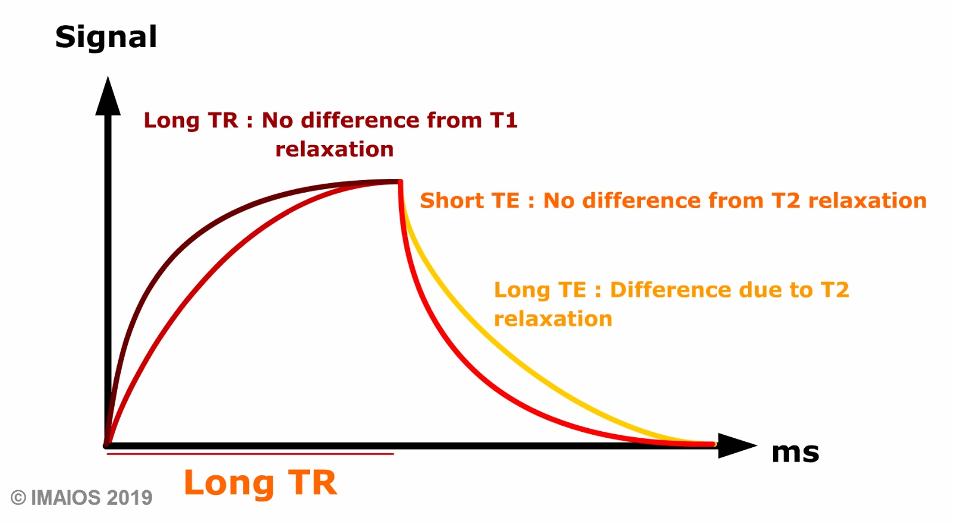
Long TR vs. Short TR, and Long TE vs Short TE
Short TR

Slide 15
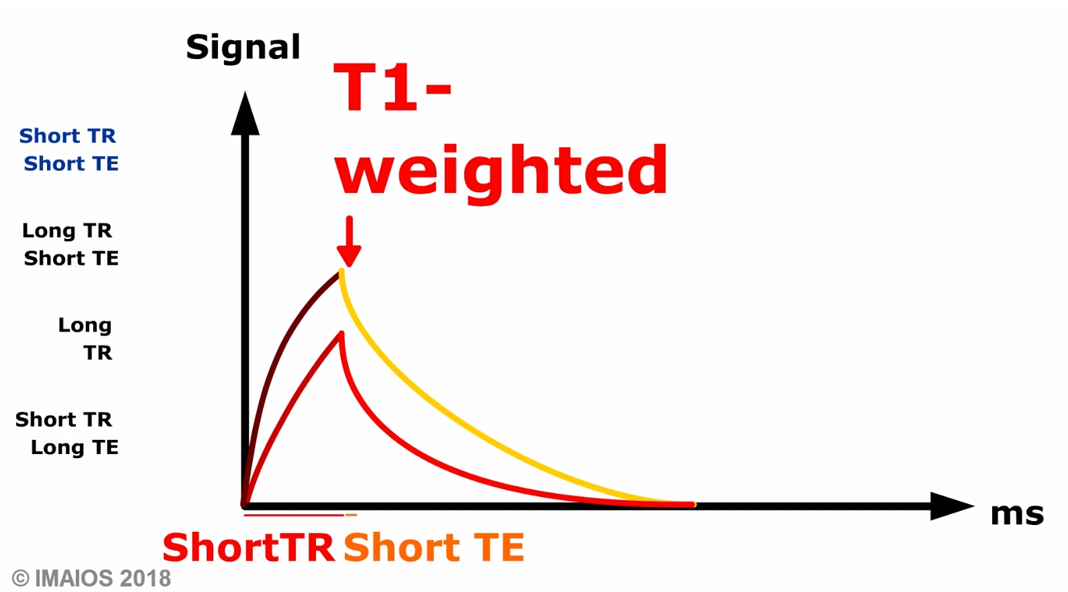
Short TR + Short TE is T1-weighted!

Slide 16
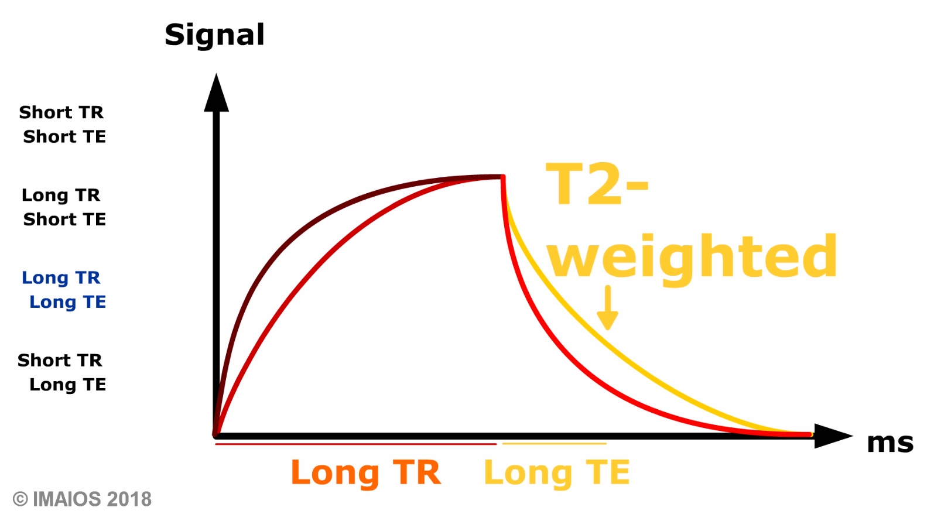
Long TR + Long TE is T2-weighted!

Slide 17
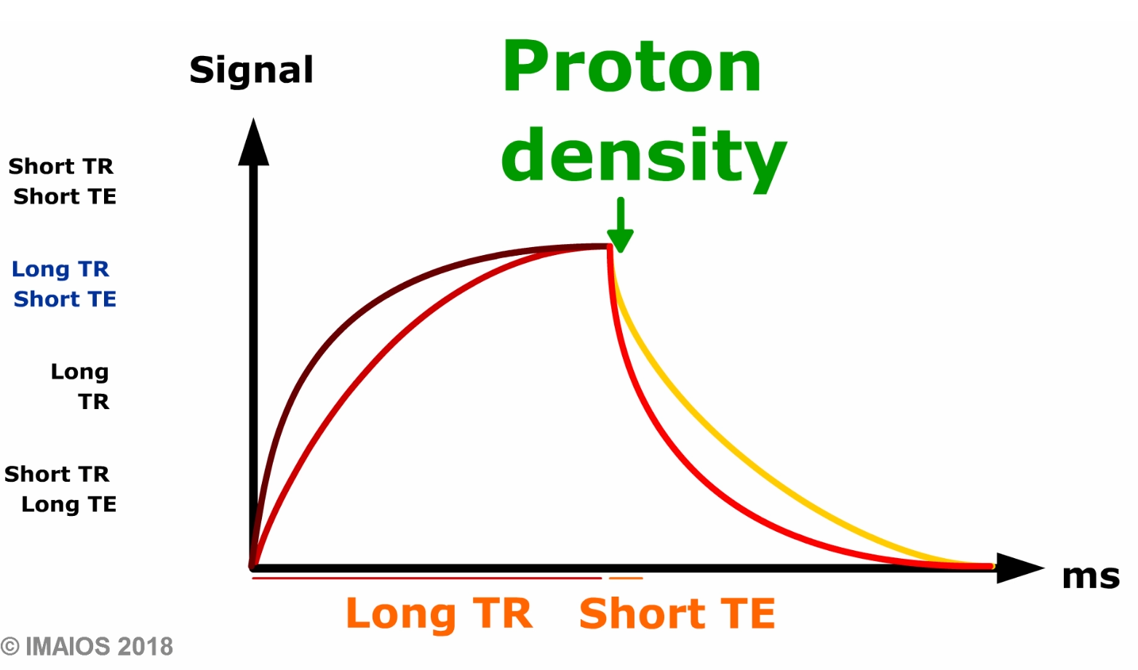
Long TR + Short TE is Proton Density-weighted!
Notes:
A short TR and short TE sequence is usually called T1-weighted
A long TR and long TE sequence is usually called T2-weighted
A long TR and short TE sequence is usually called Proton density -weighted

Slide 18
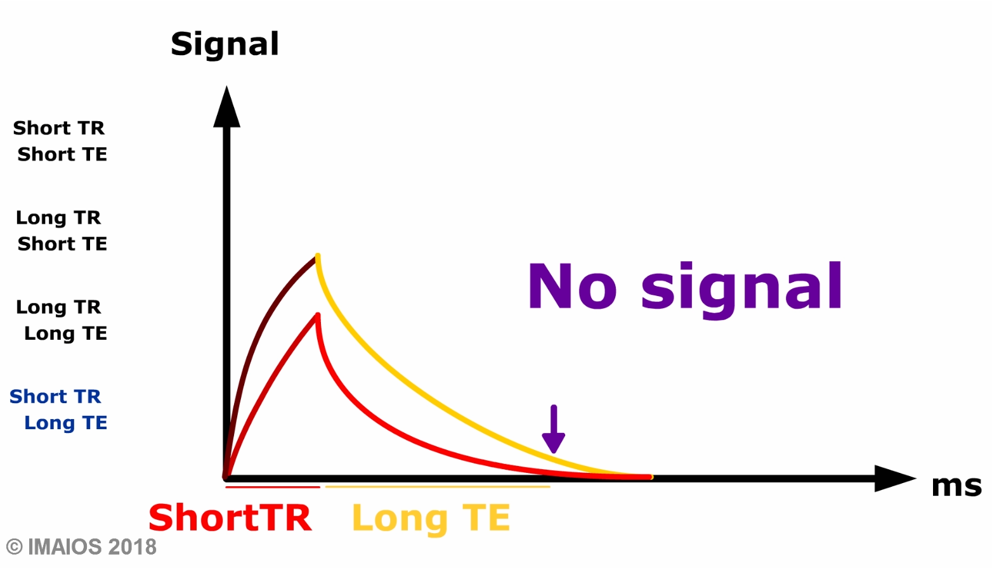

Slide 19
The majority of image contrast is determined by the flip angle of the RF pulses and the timing between RF pulses.

Slide 20
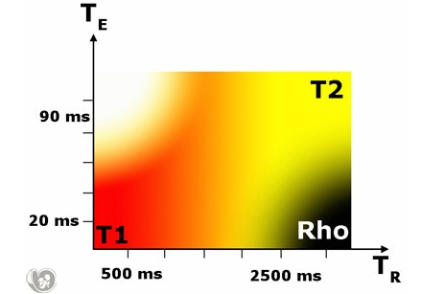
Nearly all MR image display tissue contrasts that depend on proton density, T1 and T2 simultaneously.

Slide 21
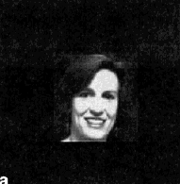
The amplitude of the MRI signal is modulated to generate image contrast.
The total number of spins in the transverse plane determines the amplitude of the MRI signal.
A Proton Density Weighted image measures the total number of spins.
T1/T2 Weighted images is the total numbers in the transverse plane that remain after the spins are allowed to evolve under their own influences.
Variations in flip angle (B1 inhomogeneity) can alter the appearance of an object.
Proton Density
T2 Weighted
T1 Weighted

Slide 22
T1 Weighted Image
Short TR maximizes T1 weighting
Short TE minimizes T2 weighting
Tissue | Relative Density | T1 [ms] | T2 [ms]
White Matter | 0.65 | 600 | 80
Grey Matter | 0.8 | 950 | 100
CSF | 1.0 | 4500 | 2200
Fat | 0.9 | 250 | 60
TR = 416ms, TE= 9ms

Slide 23
T2 Weighted Image
Tissue | Relative Density | T1 [ms] | T2 [ms]
White Matter | 0.65 | 600 | 80
Grey Matter | 0.8 | 950 | 100
CSF | 1.0 | 4500 | 2200
Fat | 0.9 | 250 | 60
TR = 5150ms, TE= 114ms

Slide 24
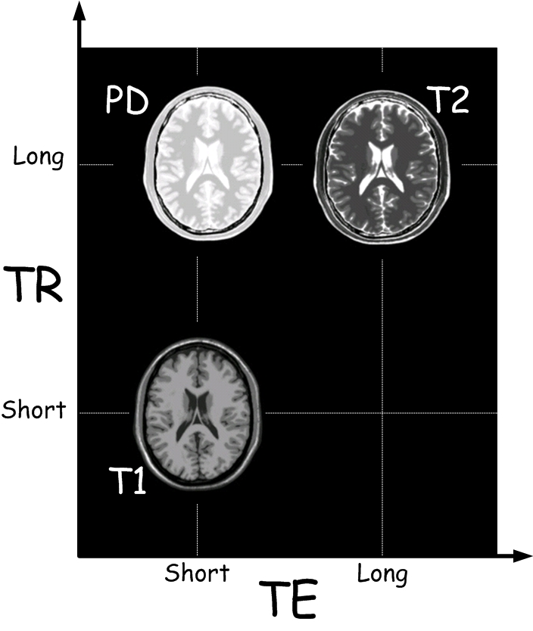
Image contrast summary for Proton Density, T2-weighted, and T1 weighted image.
Notes:
By adjusting TR and TE, we can achieve different contrast between tissues.

Slide 25
Reference: Relaxation time at 1.5T
 | T1 (ms) | T2 (ms)
Water | 3000 | 3000
Gray matter | 810 | 100
White matter | 680 | 90
Liver | 420 | 45
Fat | 240 | 85
Gadolinium | Reduces T1 | Reduces T2
Notes:
tissue with a long T1 and T2 (like water) is dark in the T1-weighted image and bright in the T2-weighted image.
A tissue with a short T1 and a long T2 is bright in the T1-weighted image and gray in the T2-weighted image.
Gadolinium contrast agents reduce T1 and T2 times, resulting in an enhanced signal in the T1-weighted image and a reduced signal in the T2-weighted image

Slide 26
Two fundamental questions about MRI.
1) What determines the contrast in an MRI image. In other words, how does the pulse sequence change the signal intensity of an individual pixel?
2) How is the signal intensity of a single pixel assigned to a particular pixel location (i.e. spatial resolution) in an MRI image?
Notes:
Changes in the amplitude (contrast) of the MRI signal are independent of changes in the phase and frequency of the MRI signal ( spatial encoding).

Slide 27
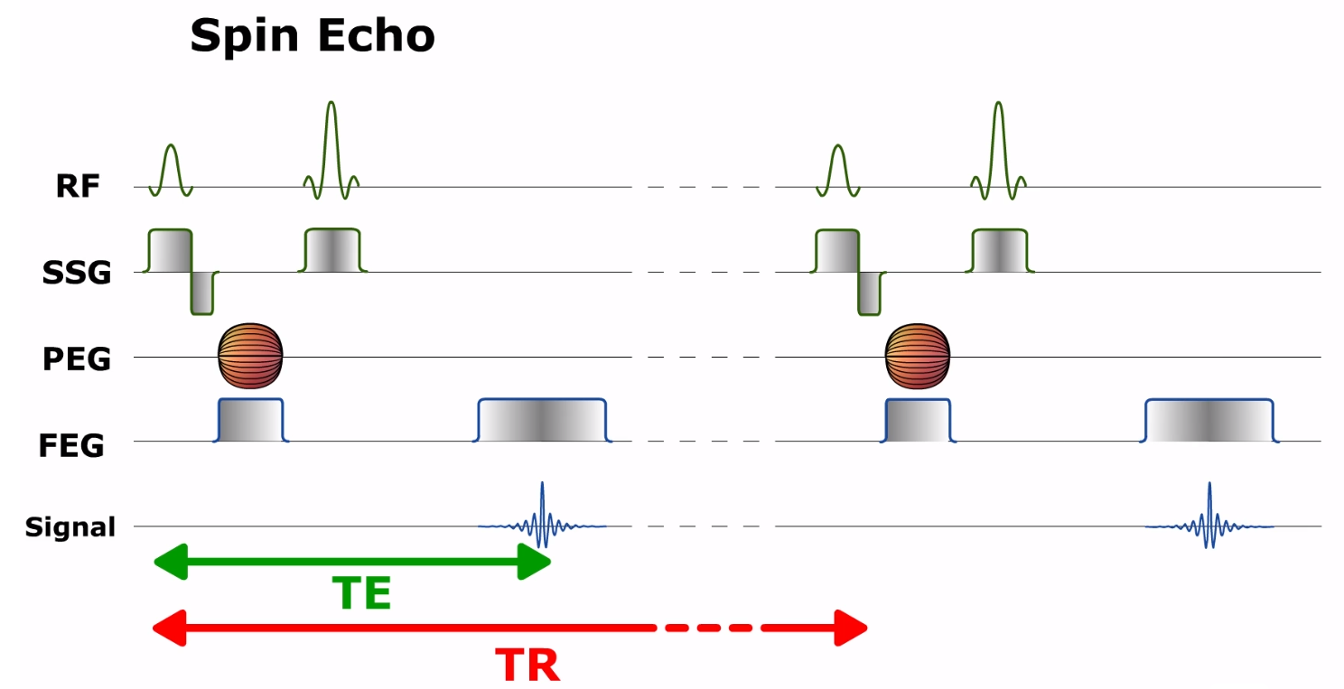
Spatial Encoding with magnetic field gradients
SSG - slice selection gradient
PEG – phase encoding gradient
FEG - frequency-encoding gradient
Notes:
Spatial encoding relies on successively applying magnetic field gradients.
First of all, a slice selection gradient (GSS) is used to select the anatomical volume of interest. Within this volume, the position of each point will be encoded vertically and horizontally by applying a phase encoding gradient (GPE), and a frequency-encoding gradient (GFE).
The different gradients used to perform spatial localization have identical properties but are applied at distinct moments and in different directions. Gradient equivalence in the three directions of space means that slices can be selected on any spatial plane. We’ll use the example of an axial plane to explain spatial encoding.
The gradient is symbolized by two triangles joined at the apex. This indicates that the gradient is bipolar with a positive component (added to B0) and a negative component (subtracted from B0).

Slide 28
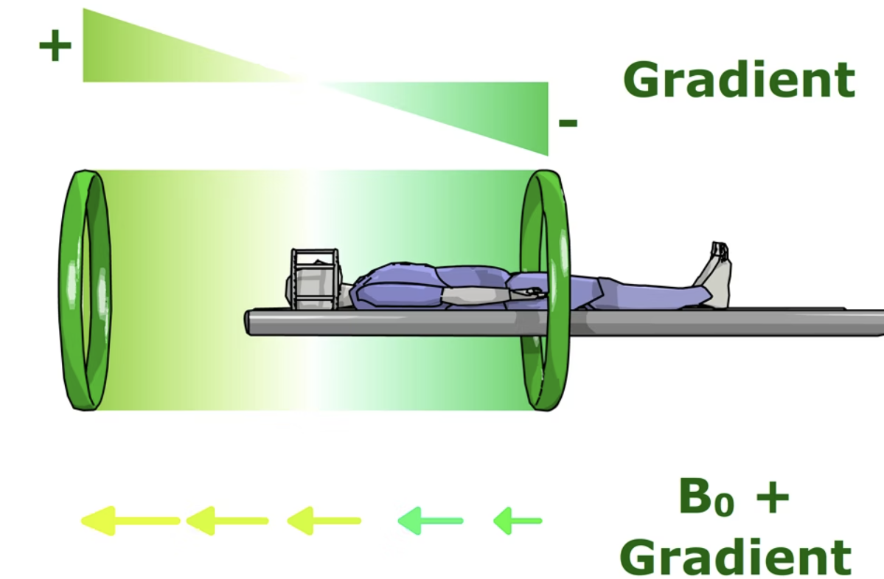
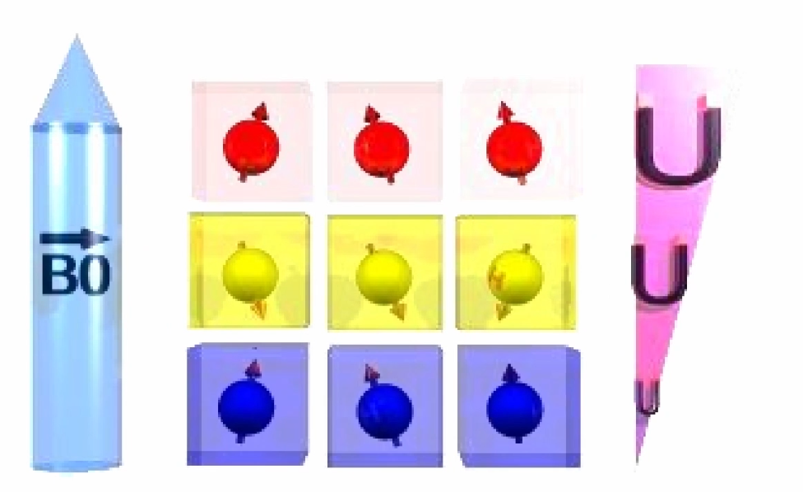
SSG - slice selection gradient

Slide 29
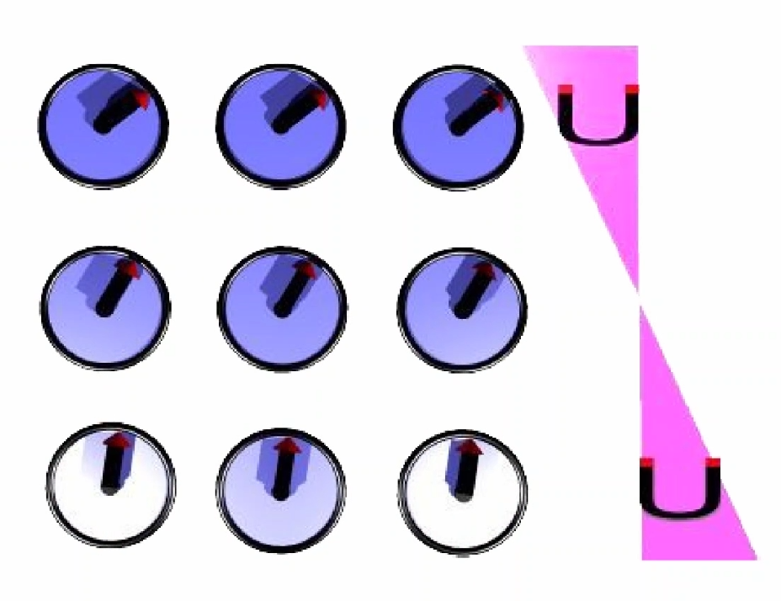
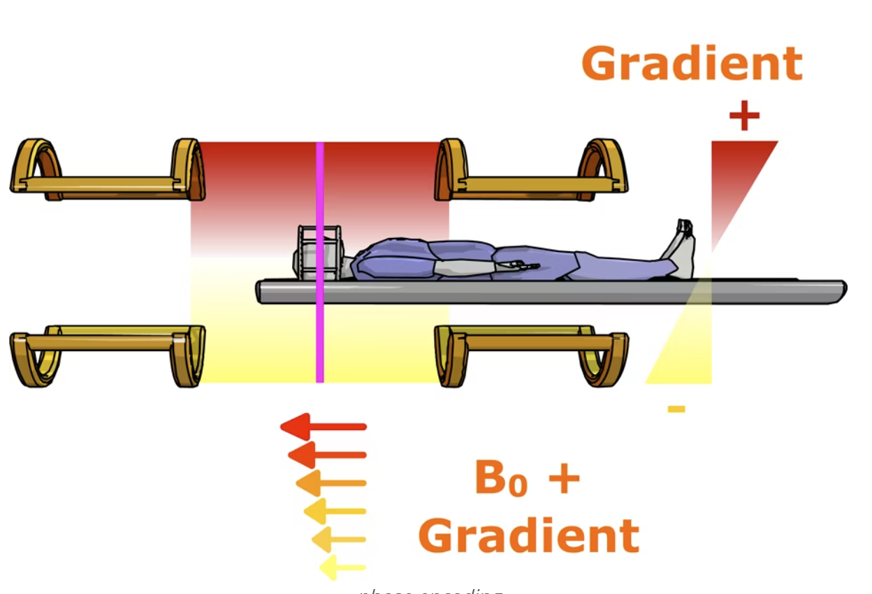
PEG – phase encoding gradient

Slide 30
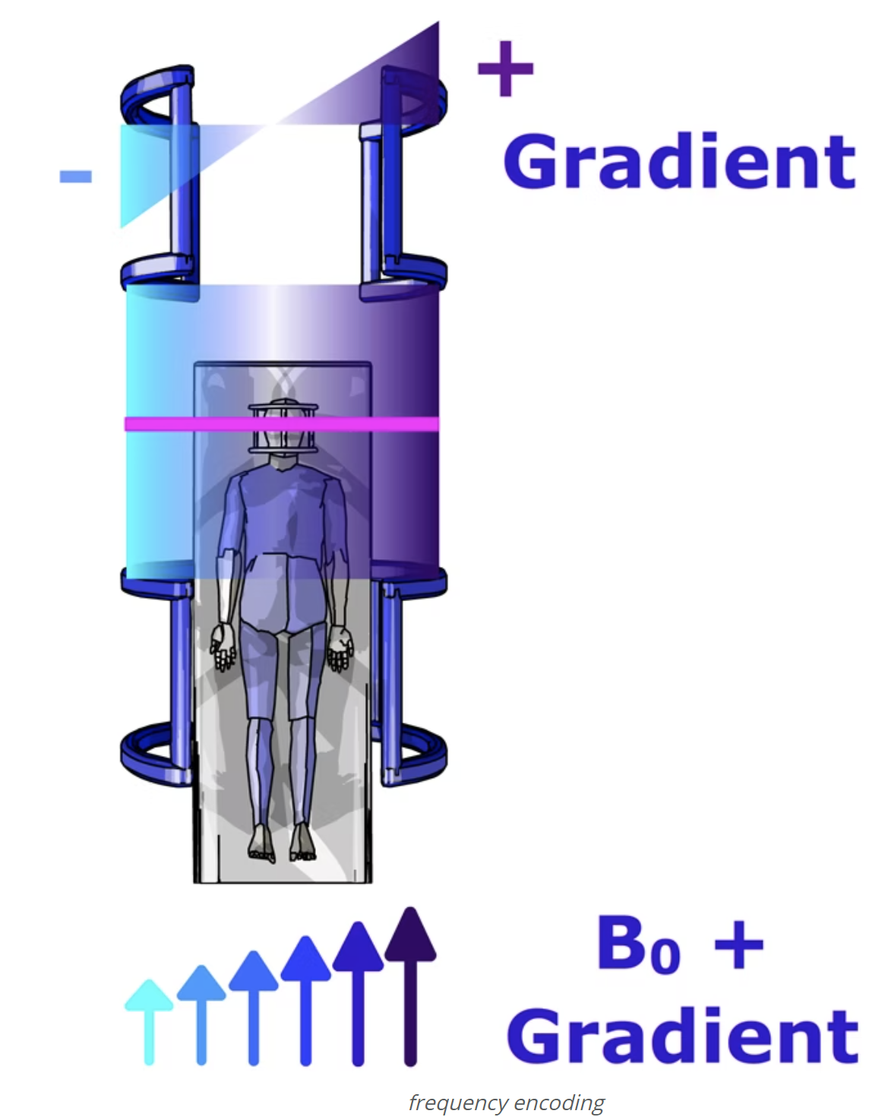
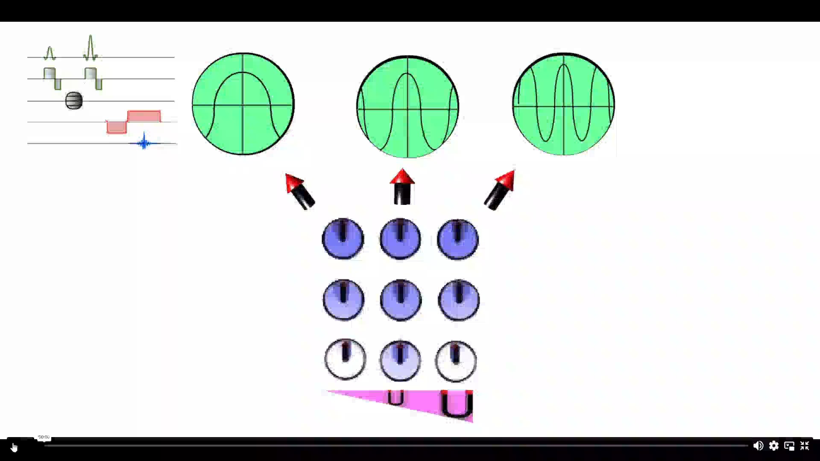
FEG - frequency-encoding gradient

Slide 31
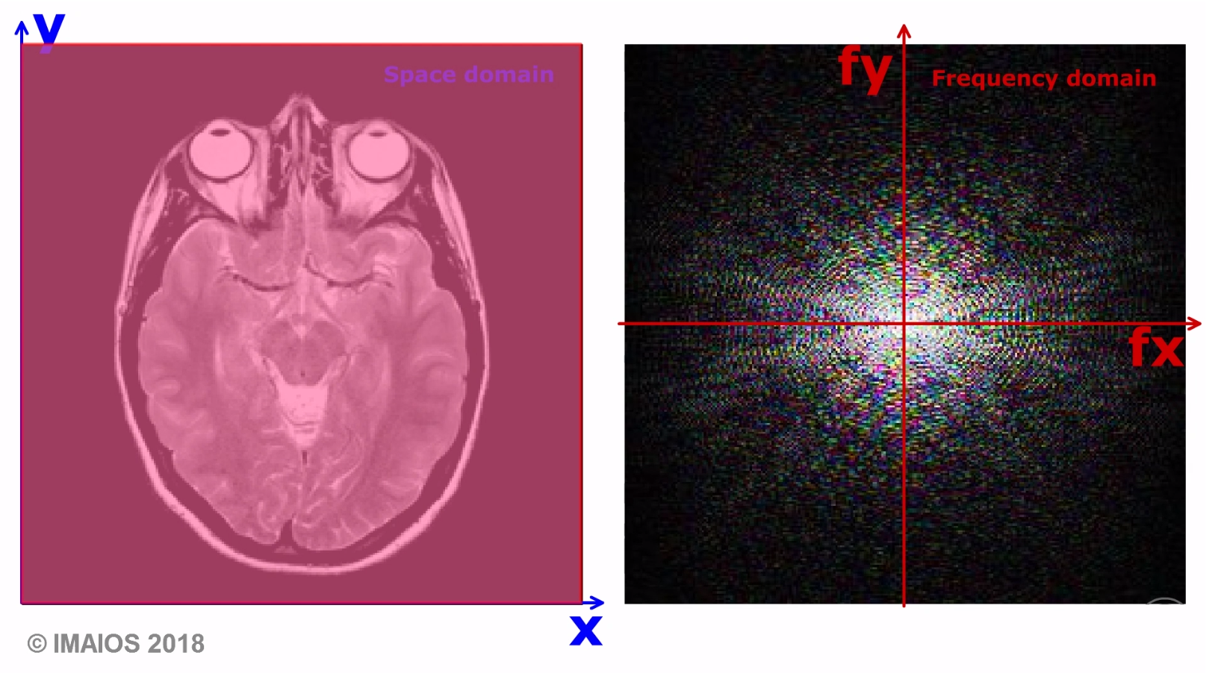
Image Domain to Frequency Domain through FT

Slide 32
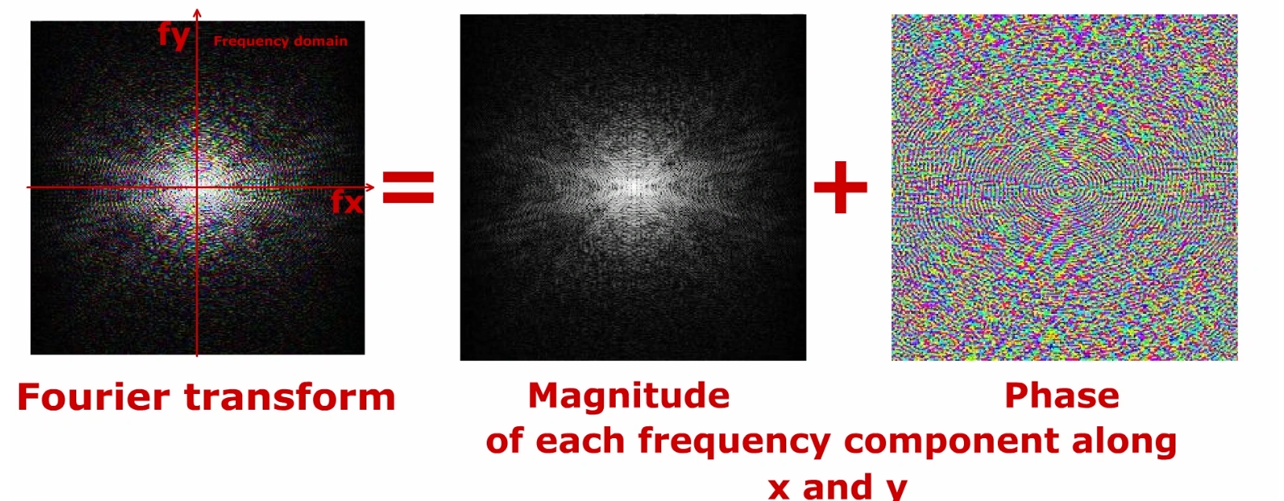

Slide 33
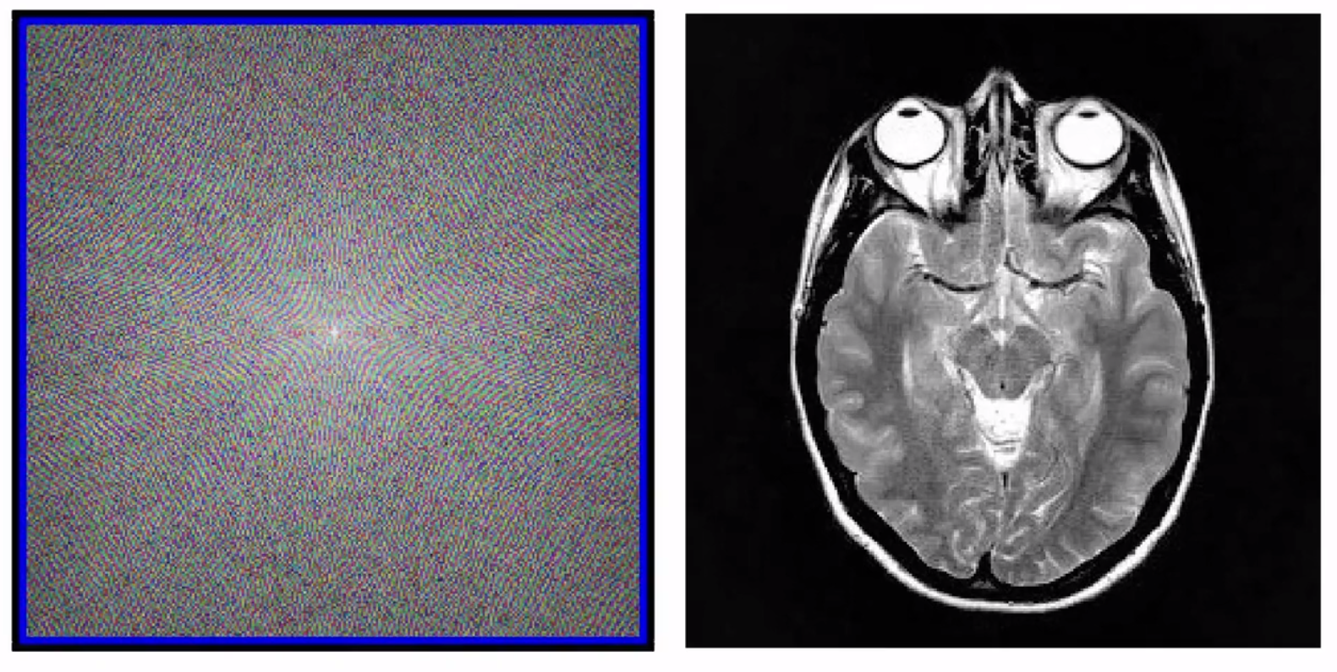
Image Reconstruction is Inverse 2D FT.

Slide 34

Why can MRI recon use iFFT directly?
Notes:
Sampling line by line in cartesian coordinate, while CT samples line by line in polar coordinate.

Slide 35
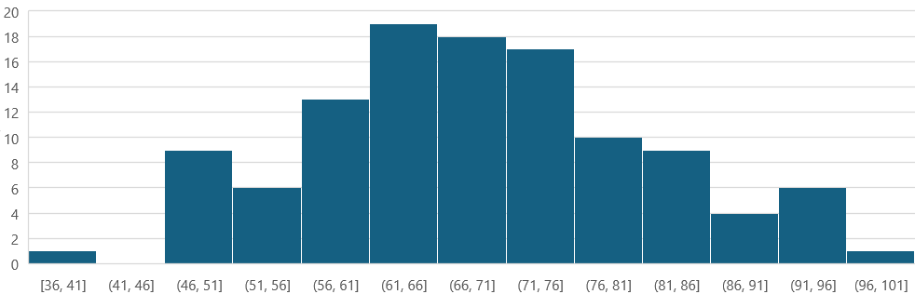
2024期中考试成绩分布
5月29日课程调整到6月初，具体日期等教务系统排课安排。

